Slide 1
Section R.1
Real Numbers
Copyright © 2012 Pearson Education, Inc. Publishing as Prentice Hall.

Slide 2

Copyright © 2012 Pearson Education, Inc. Publishing as Prentice Hall.

Slide 3

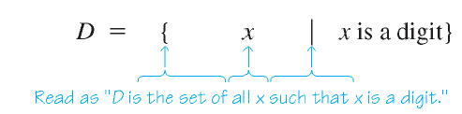
Copyright © 2012 Pearson Education, Inc. Publishing as Prentice Hall.

Slide 4

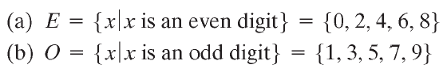
Copyright © 2012 Pearson Education, Inc. Publishing as Prentice Hall.

Slide 5
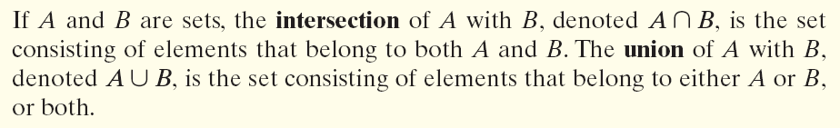
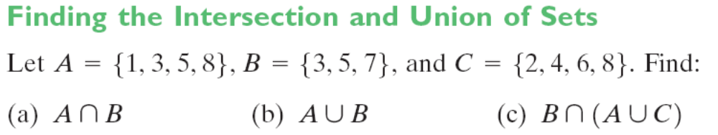

Copyright © 2012 Pearson Education, Inc. Publishing as Prentice Hall.

Slide 6
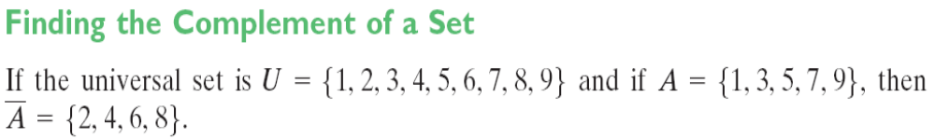
Copyright © 2012 Pearson Education, Inc. Publishing as Prentice Hall.

Slide 7
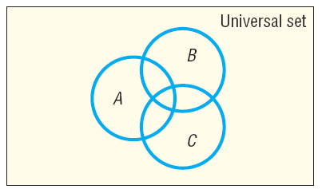

Copyright © 2012 Pearson Education, Inc. Publishing as Prentice Hall.

Slide 8
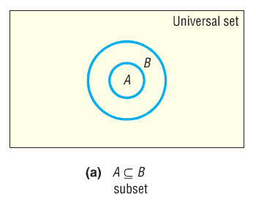
Copyright © 2012 Pearson Education, Inc. Publishing as Prentice Hall.

Slide 9
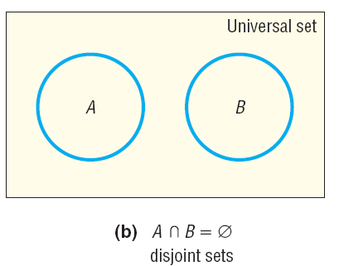
Copyright © 2012 Pearson Education, Inc. Publishing as Prentice Hall.

Slide 10
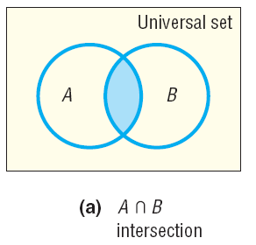
Copyright © 2012 Pearson Education, Inc. Publishing as Prentice Hall.

Slide 11
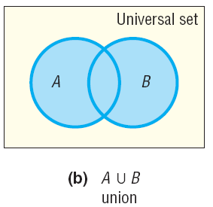
Copyright © 2012 Pearson Education, Inc. Publishing as Prentice Hall.

Slide 12
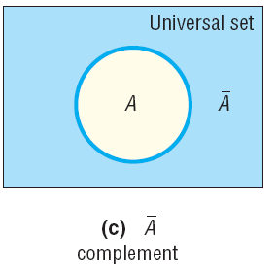
Copyright © 2012 Pearson Education, Inc. Publishing as Prentice Hall.

Slide 13

Copyright © 2012 Pearson Education, Inc. Publishing as Prentice Hall.

Slide 14
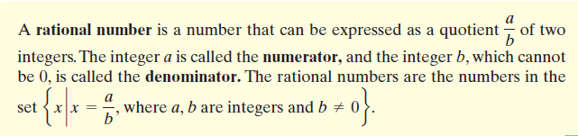
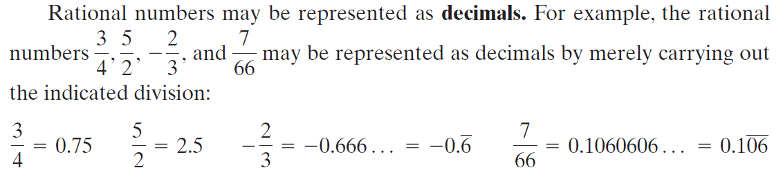
Copyright © 2012 Pearson Education, Inc. Publishing as Prentice Hall.

Slide 15

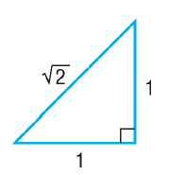
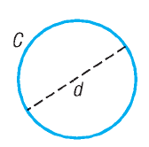

Some decimals do not terminate or end in a pattern. Such decimals represent irrational numbers. Every irrational number may be represented by a decimal that neither repeats nor terminates. In other words, irrational numbers cannot be
written in the form , where a, b are integers and b ≠ 0.
Copyright © 2012 Pearson Education, Inc. Publishing as Prentice Hall.

Slide 16
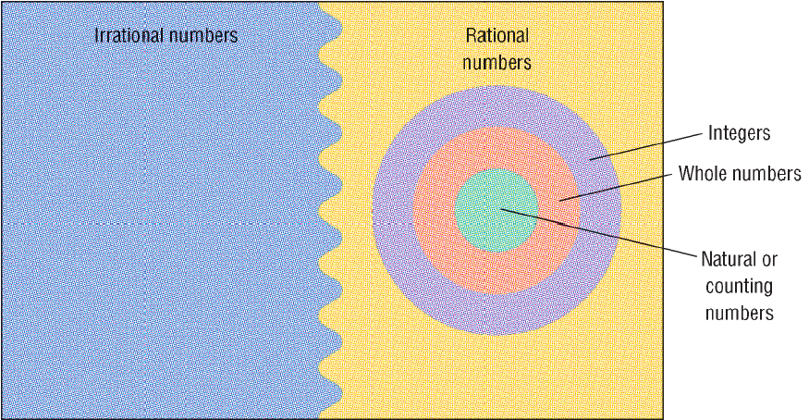
Real numbers
Copyright © 2012 Pearson Education, Inc. Publishing as Prentice Hall.

Slide 17
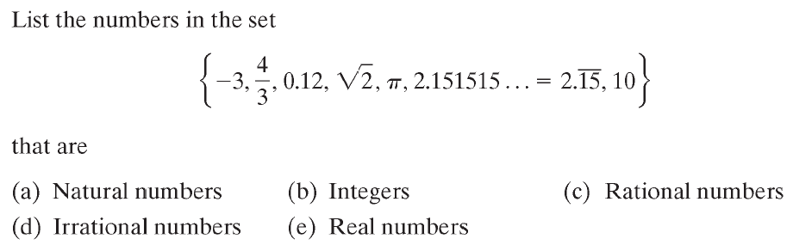



Copyright © 2012 Pearson Education, Inc. Publishing as Prentice Hall.

Slide 18

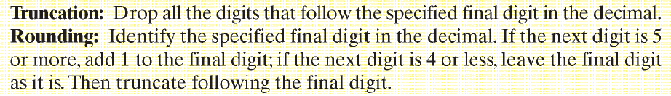

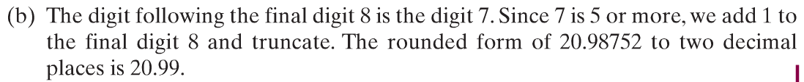
Copyright © 2012 Pearson Education, Inc. Publishing as Prentice Hall.

Slide 19
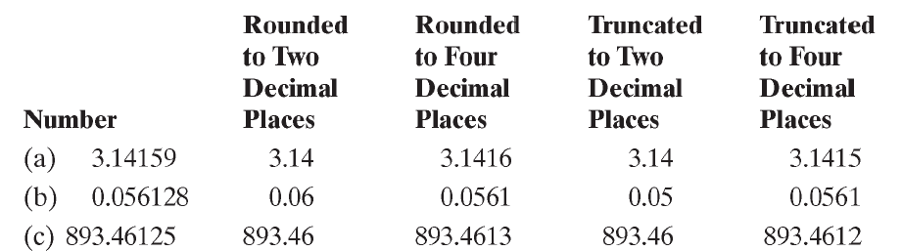
Copyright © 2012 Pearson Education, Inc. Publishing as Prentice Hall.

Slide 20

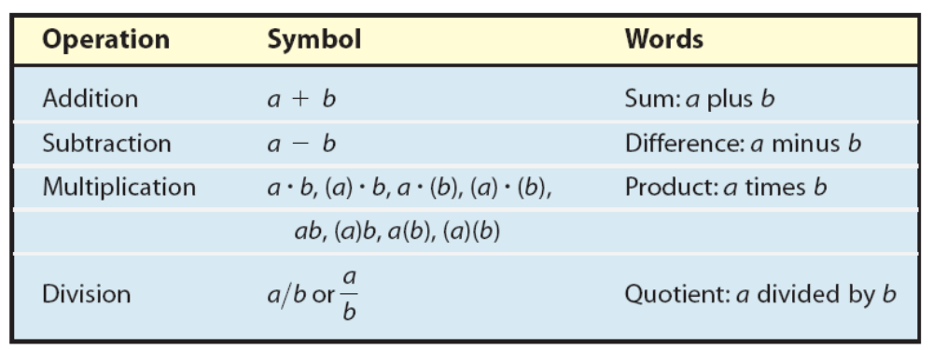
Copyright © 2012 Pearson Education, Inc. Publishing as Prentice Hall.

Slide 21
Copyright © 2012 Pearson Education, Inc. Publishing as Prentice Hall.

Slide 22

Copyright © 2012 Pearson Education, Inc. Publishing as Prentice Hall.

Slide 23
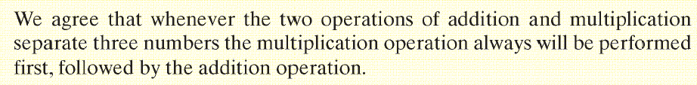
Copyright © 2012 Pearson Education, Inc. Publishing as Prentice Hall.

Slide 24

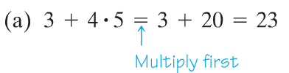
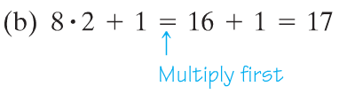

Copyright © 2012 Pearson Education, Inc. Publishing as Prentice Hall.

Slide 25

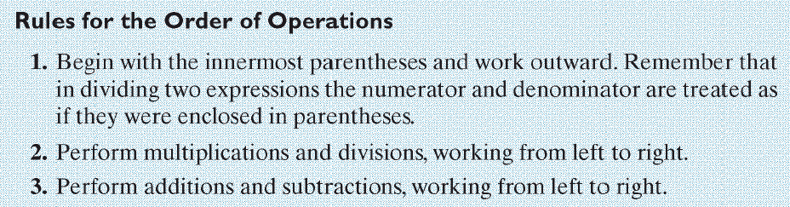
Copyright © 2012 Pearson Education, Inc. Publishing as Prentice Hall.

Slide 26
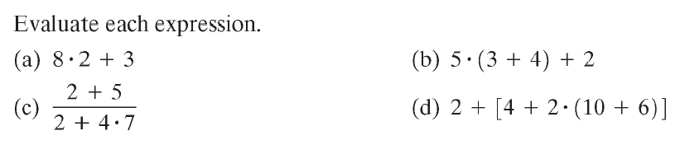

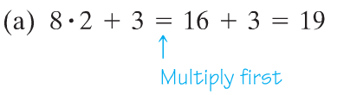
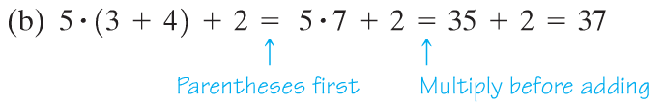
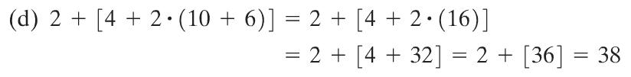
Copyright © 2012 Pearson Education, Inc. Publishing as Prentice Hall.

Slide 27
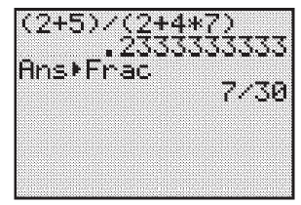
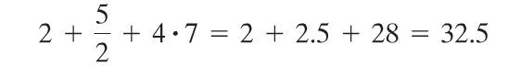
Be careful if you use a calculator. For example when you compute (c) above, you need to use parentheses (see calculator screenshot below). If you don’t, your answer will be incorrect because the calculator will compute the expression
Copyright © 2012 Pearson Education, Inc. Publishing as Prentice Hall.

Slide 28
Copyright © 2012 Pearson Education, Inc. Publishing as Prentice Hall.

Slide 29
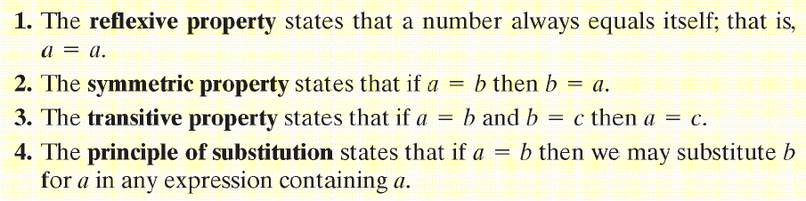
Copyright © 2012 Pearson Education, Inc. Publishing as Prentice Hall.

Slide 30
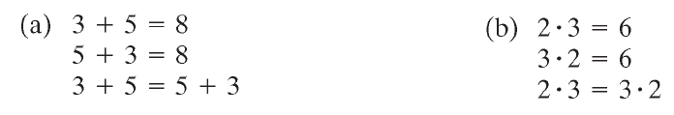


Copyright © 2012 Pearson Education, Inc. Publishing as Prentice Hall.

Slide 31

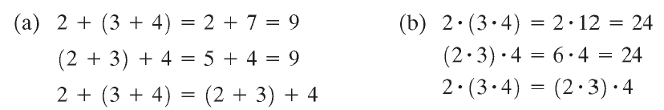


Copyright © 2012 Pearson Education, Inc. Publishing as Prentice Hall.

Slide 32



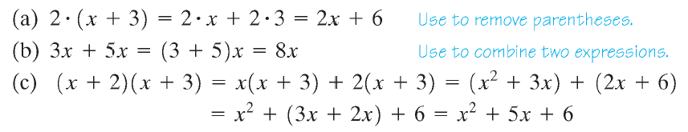
Copyright © 2012 Pearson Education, Inc. Publishing as Prentice Hall.

Slide 33



Copyright © 2012 Pearson Education, Inc. Publishing as Prentice Hall.

Slide 34




Copyright © 2012 Pearson Education, Inc. Publishing as Prentice Hall.

Slide 35



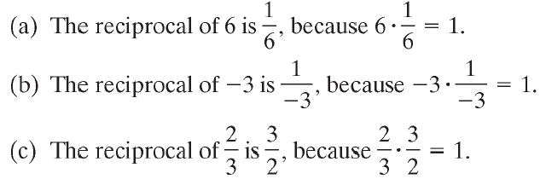
Copyright © 2012 Pearson Education, Inc. Publishing as Prentice Hall.

Slide 36
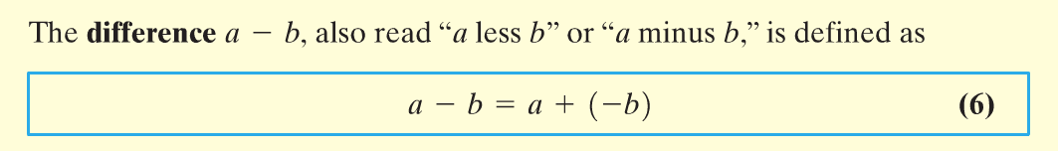
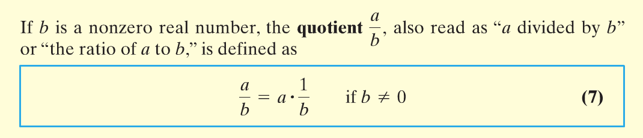
Copyright © 2012 Pearson Education, Inc. Publishing as Prentice Hall.

Slide 37
Copyright © 2012 Pearson Education, Inc. Publishing as Prentice Hall.

Slide 38




Copyright © 2012 Pearson Education, Inc. Publishing as Prentice Hall.

Slide 39

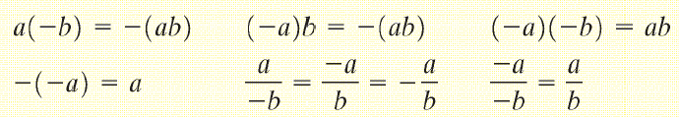
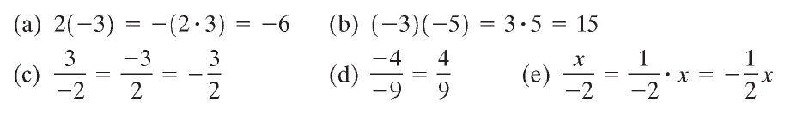
Copyright © 2012 Pearson Education, Inc. Publishing as Prentice Hall.

Slide 40

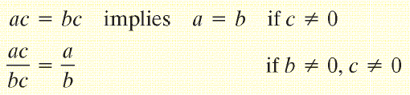
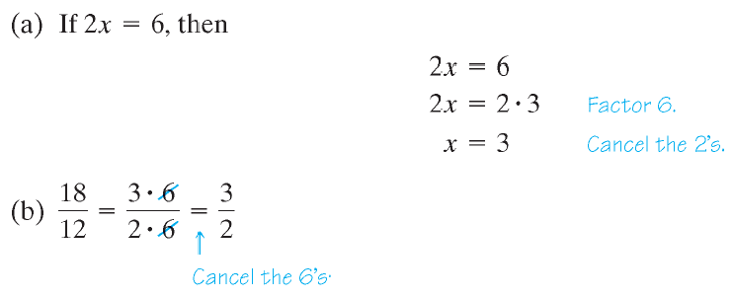
Copyright © 2012 Pearson Education, Inc. Publishing as Prentice Hall.

Slide 41

Copyright © 2012 Pearson Education, Inc. Publishing as Prentice Hall.

Slide 42

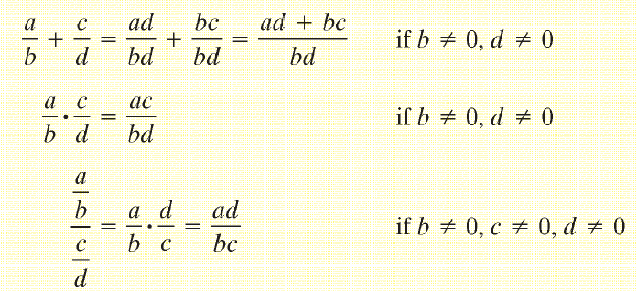
Copyright © 2012 Pearson Education, Inc. Publishing as Prentice Hall.

Slide 43



Copyright © 2012 Pearson Education, Inc. Publishing as Prentice Hall.

Slide 44

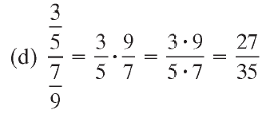
Copyright © 2012 Pearson Education, Inc. Publishing as Prentice Hall.

Slide 45
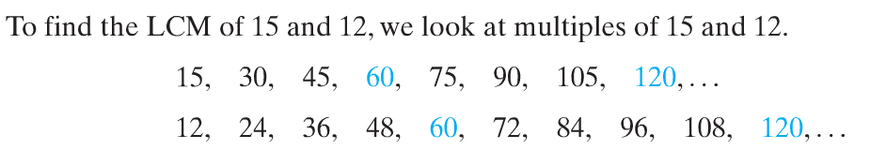
Copyright © 2012 Pearson Education, Inc. Publishing as Prentice Hall.

Slide 46

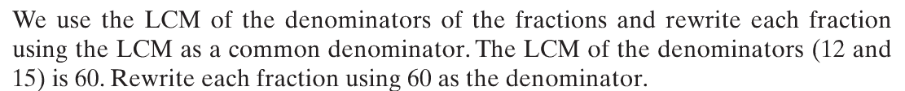





Copyright © 2012 Pearson Education, Inc. Publishing as Prentice Hall.

